Slide 1

EXAM PORTAL
Hüseyin Gökay
Muratcan Kılıçcı

Slide 2

The Exam Portal is going to have two user roles namely instructor and student.

Slide 3
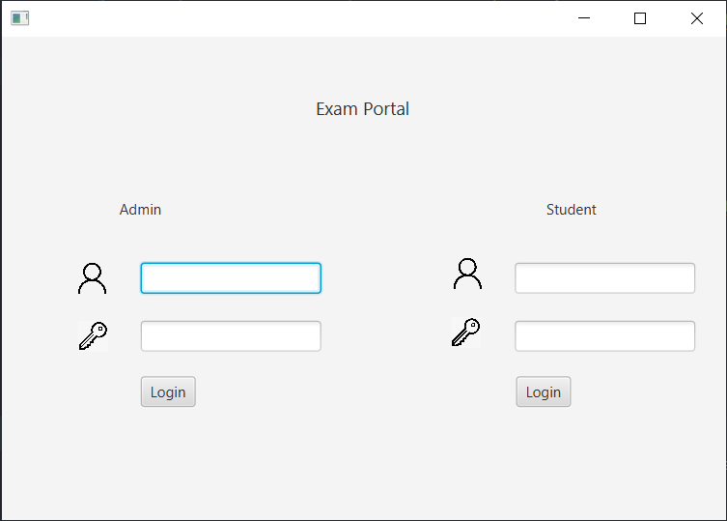
The Login Page of the System

Slide 4

The Instructor side of the system:
Instructors are able to create new exams by using different type of questions
Instructors are able to edit the exam that has been already created
Instructors are able to delete the exams

Slide 5
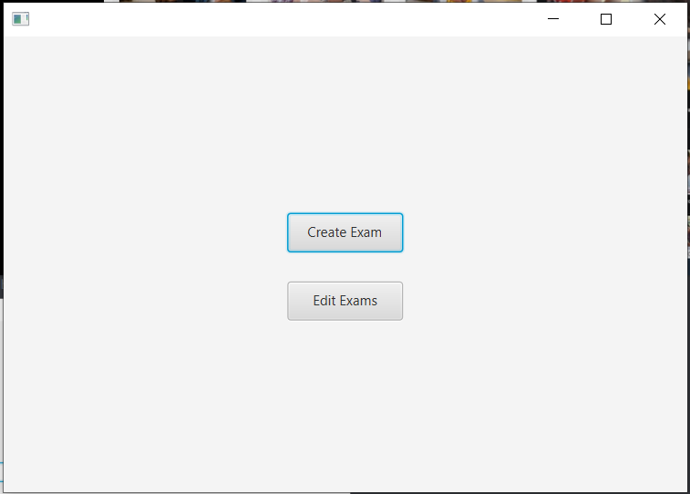
The Instructor Screen

Slide 6
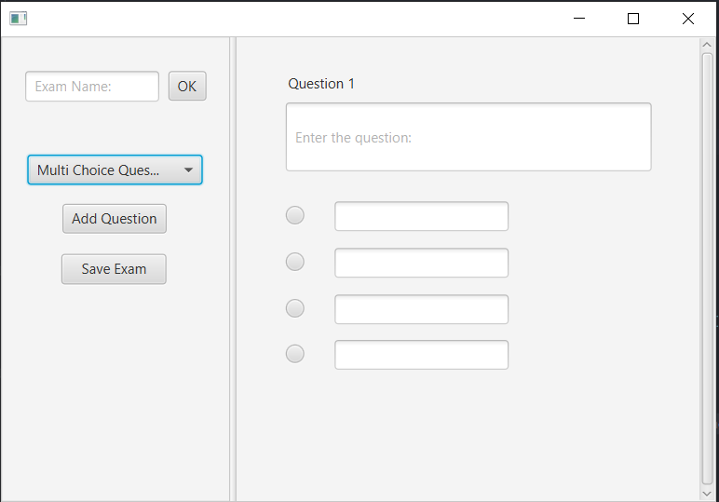
The Create Exam Screen

Slide 7

The student side of the system:
The students are able to see their all exams that they are assigned to it
The students are able to take the exam that they are assigned to it

Slide 8
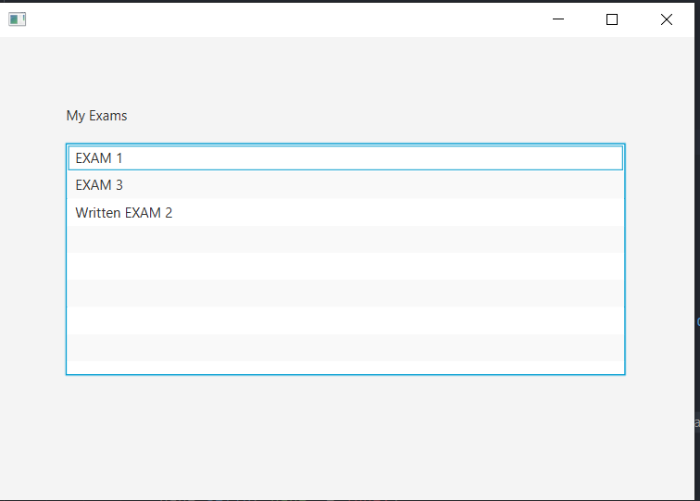
My Exams Screen for the Students

Slide 9
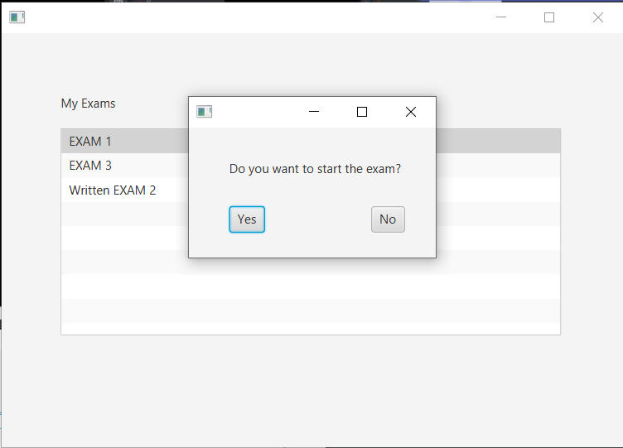
Students are able to take their exams by accepting YES Button

Slide 10

Thank you for listening...

